Slide 1


Parent Peer Group
Parent Pilot Kit
FOUR-PART
Parent Pilot Kit
PRESENTATION
Informed Families | Copyright 2022 | Proprietary
Notes:
Refer to Handouts, brochures or informedfamilies.org links for additional information

Slide 2


Slide 3


About Us
Informed Families is a grassroot non-profit organization founded in 1982.
We offer four campaigns a year:
Family Time
Red Ribbon
Lock Your Meds
Safe Home Smart Parents

Slide 4

Contact Information
Informed Families Headquarters
2490 Coral Way
Miami, Fl 33145
www.informedfamilies.org
Christine Stilwell
Statewide Director
cstilwell@informedfamilies.org
(321) 231-0587
Mery N. Domínguez
Consultant | Program Facilitator, Miami
mdominguez@informedfamilies.org
(786) 708-7508
Sharon Warner
Consultant | Program Facilitator, Orlando
swarner@informedfamilies.org
(407) 435-4096
Melanie Williams
Program Assistant, Orlando
mwilliams@informedfamilies.org
(321) 945-1311
Informed Families | Copyright 2021 | Proprietary

Slide 5

Four-Part Series
The PPG Agendas:
  The Brain
  The Media
  Social Norms
  Parenting Styles & Parent Peer Group Volunteers
Informed Families | Copyright 2021 | Proprietary
Notes:
SESSION 1– PART I (1.5 Hrs)
Welcome – housekeeping (ground rules, breaks, bathrooms) 10 min
Tip of the Iceberg – 10 min.
Pre survey for participant competencies
5.History – 10 min.
BREAK???
Parent Peer Group – What Is It – 20 min
The Parent Pilot Kit – What Is It - 20 min
The Brain
Brain Post tests or continue to Session 2 (The Media
Media Agenda– Pre-Test
Media Agenda 2 –(30 min.)
Media Agenda 2 Post-test
Break
The PPG Social Norms
PPG Agendas 3 Pre-test

Slide 6
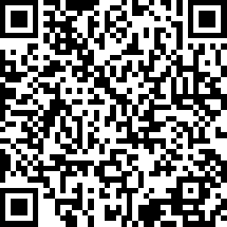
PPG Training
Pre-Survey
https://www.surveymonkey.com/r/PPGPRE1234
Notes:
Pre test: https://www.surveymonkey.com/r/PPGPRE1234
If conducting the presentation in 4-parts you can use the individual links.

Slide 7
What is a Parent Peer Group?
What is the Purpose of a Parent Peer Group?
A parent peer group is a group of parents whose children are friends, neighbors or classmates.
The PPG recognizes that:
  Parents are the most important influence in a child’s life
  Parents are no longer sure this is true
  Parents must learn to be the leaders in their families
  Parents must learn to influence their child’s environment
  Parents need a network of support
Informed Families | Copyright 2021 | Proprietary
Notes:
PPG provides you with a tool to educate and unite parents in a process to help kids grow up safe, healthy and drug free. The information shared is known as the PPK (Parent Pilot Kit).

Slide 8
PPG Certification Training Available
Ask for details. cstilwell@informedfamilies.org
You must complete the 4 Agendas prior to PPG Leader Training.
Notes:
See reference materials.

Slide 9


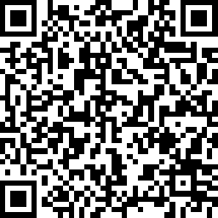
Brain Development and the Effects of Alcohol/Drugs
Agenda One
Informed Families
Parent Peer Group
https://www.surveymonkey.com/r/PPGAgenda1-pre
Notes:
Handout Pre-Surveys (paper-based) or use link – Brain https://www.surveymonkey.com/r/PPGAgenda1-pre

Slide 10

Just the Tip of the Iceberg
Only 10% of an iceberg is above water
Notes:
Understand where people are coming from before you interact with them
Give Iceberg handout
Most of what makes up a person is behind the scenes. (you cannot see it)
To be successful in delivering the PPG, you must embrace the iceberg principal
- only 10% of an iceberg is above water
You must look below the surface to avoid danger
Do the “High There” exercise
-90% of communication is non verbal (below the surface)
-It’s important to scan people and their environment

Slide 11
Arc of Distortion
Clear Message
Listening through a personal filter creates distortion
Distorted Message
Informed Families | Copyright 2021 | Proprietary
Notes:
People may have a distorted view of the world. A knowledge their distortion (situation) before you can change their behavior.

Slide 12
The Thought Cycle
THOUGHT
Thoughts Influence behaviors
REACTION/ CONSEQUENCE
FEELING
BEHAVIOR/ ACTION
Informed Families | Copyright 2021 | Proprietary
Notes:
-Each person experiences life through his/her own reality and a child’s reality is different than an adult’s.
-

Slide 13
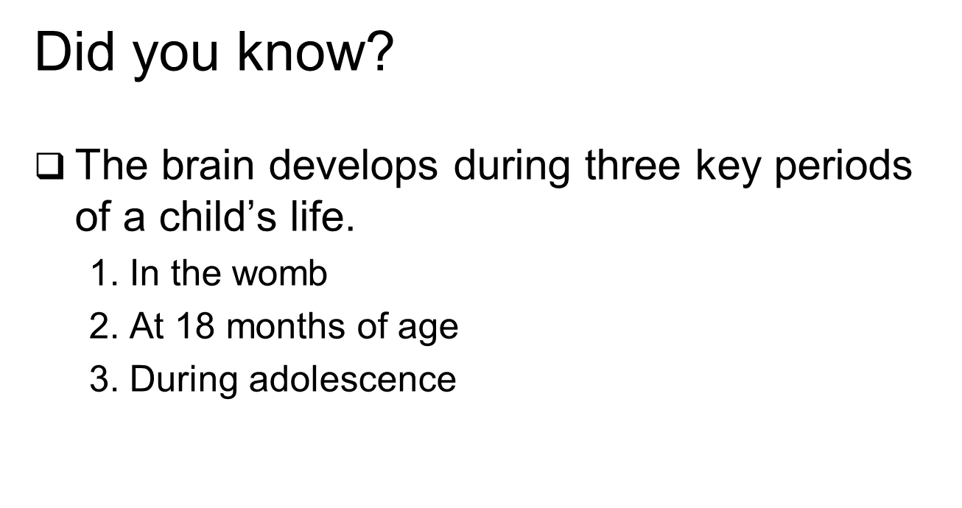
Brain Development
Informed Families | Copyright 2021 | Proprietary
Notes:
13

Slide 14
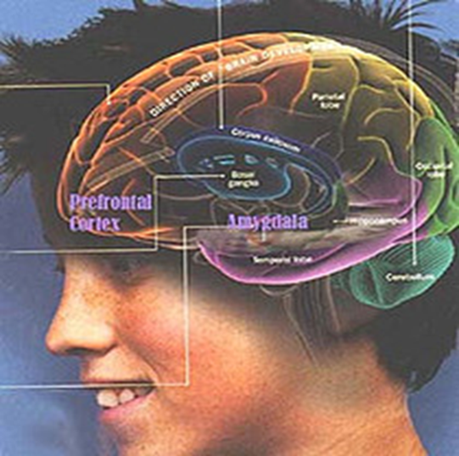
Brain Development
The brain is not fully developed until age 25.
National Institute of Health, National Institute of Alcohol Abuse and Alcoholism. Alcohol Alert: Underage Drinking. Number 67, January 2006
Informed Families | Copyright 2021 | Proprietary
Notes:
14
This brain region gives an individual the capacity to exercise “good judgment” when presented with difficult life situations. Brain research indicating that brain development is not complete until near the age of 25, refers specifically to the development of the prefrontal cortex.

Slide 15
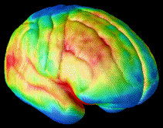

Brain Development
Images of brain development in healthy youth (ages 5 – 20)
Maturation occurs from back to front of the brain
Blue represents maturing of brain areas
Source: Gogtay, Giedd, et al., 2004.
Notes:
15

Slide 16
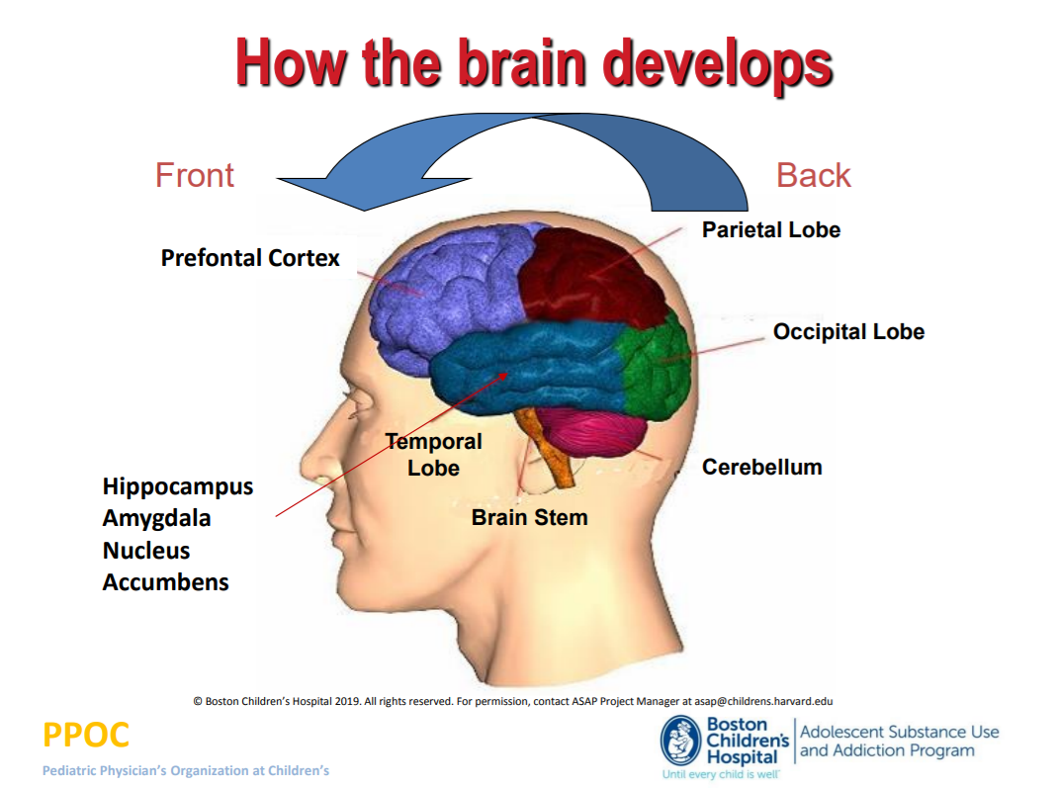

Notes:
The prefrontal cortex is one of the last regions of the brain to reach maturation. This delay may help to explain why some adolescents act the way they do.

Slide 17
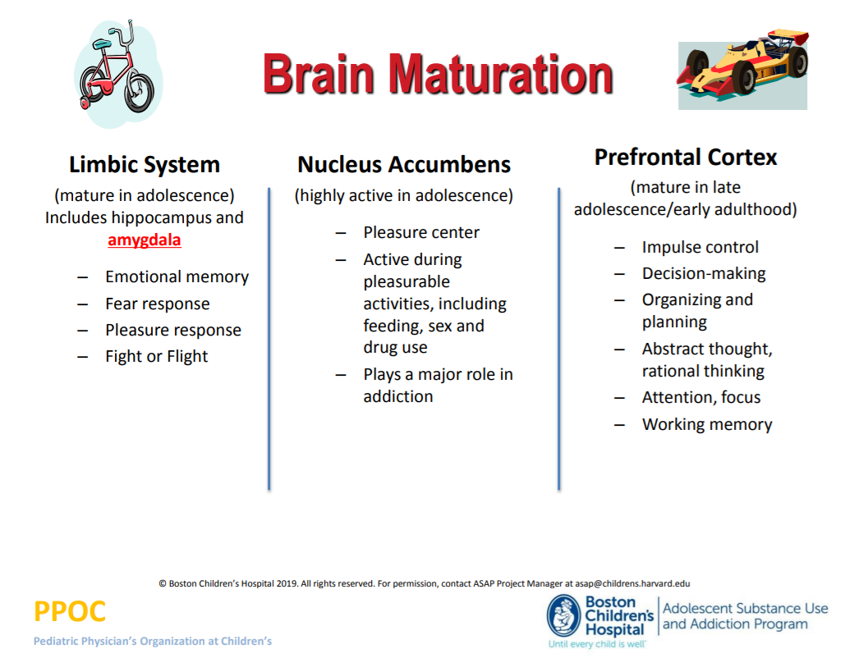

Slide 18
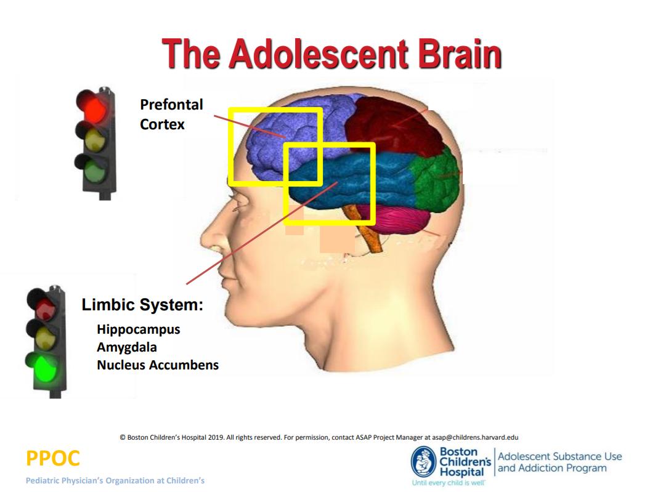
Notes:
-The drives, impulses and emotions as well as changes in motivation that accompany puberty arise before self-control and mature judgement are fully developed.
-The complex neurobehavioral changes that occur in adolescence interact with the social context of adolescence in ways that may further increase risk.

Slide 19
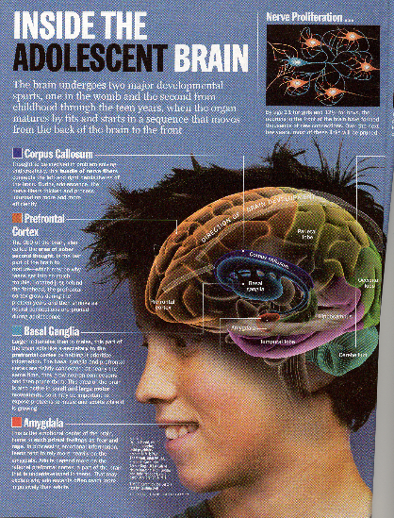
Construction Ahead
During late childhood, neurons get bushier and increase in the number of connections.
At about age 11 in girls and age 12½ in boys, this thickening undergoes pruning.
At the same time, the myelin sheaths that encase nerve cells thicken.
  Myelin sheaths are like insulation on a wire; they make nerve cell transmissions faster and more efficient
Source: Ken Winters, Ph.D.
Notes:
The onset of puberty activates new drives, impulses and emotions as well as changes in motivation the decrease in external constraints that attends the beginning of adolescence increases the risk of a number of health problems including alcohol and drug use.

Slide 20


Brain Development
Teens’ bodies develop ahead of their brains
Informed Families | Copyright 2021 | Proprietary
Notes:
20
Approaches to prevention and strategies for early identification of children at risk should consider biological, psychological, and social development as well as interaction between factors in determining vulnerability to a variety of health problems.

Slide 21
Brain Development
Puberty activates new drives, impulses & emotions motivations change
These changes occur before self-control & judgment are fully developed
Informed Families | Copyright 2021 | Proprietary
Notes:
21
Or to put it another way, it’s almost like a train wreck looking for a place to happen.

Slide 22
Brain Development
What happens to a child’s brain on alcohol?
Impaired judgement and lack of impulse control. The child will think, speak & move slower
The child’s vision may get blurry: the child may slur his/her words; and could have decreased hearing and trouble smelling and tasting
The child could experience a blackout- not being able to remember entire events, such as what he/she did last night- from drinking a lot of alcohol)
Breathing and heart rate slows, your child’s temperature lowers, and your child could go into a coma
Blood pressure goes up and heart rate decreases
Informed Families | Copyright 2021 | Proprietary
Notes:
22
Alcohol-dependent and comparison adolescents completed a 2-hour test battery designed to measure verbal and nonverbal learning and memory perception of spatial relationships, language skills, attention and problem-skills.

Slide 23
Brain Development
Research shows that the later a child starts drinking, the less likely they are to become alcohol dependent and vice versa
Children who drink before age 15 are 5 times more likely to have alcohol problems when they are adults
Informed Families | Copyright 2021 | Proprietary
Notes:
23
Children begin to acquire alcohol expectancies at a very young age (perhaps as young as 3 or 4 years old). However, by fifth and sixth grade, these expectancies whether or not they have had any personal experience with consuming alcoholic beverages.

Slide 24
Brain Development
What are some of the dangers of teens drinking or using drugs?
________________________________________________________________________________________________________________________________________________________________________________
Informed Families | Copyright 2021 | Proprietary
Notes:
24

Slide 25
Brain Development
Teen Drinking and Driving
Motor vehicle crashes are the leading cause of death for U.S. teens.
In 2010, seven teens (ages 16 to 19) died every day from motor vehicle injuries.
Per mile driven, teen drivers ages 16 to 19 are three times more likely than drivers aged 20 and older to be in a fatal crash.
Centers for Disease Control and Prevention. (2012). National Center for Injury Prevention and Control, Centers for Disease Control and Prevention (producer). [Cited 2012 Sept 28].
Informed Families | Copyright 2021 | Proprietary

Slide 26
Brain Development
Teen Drinking and Driving
Among male drivers between 15 and 20 years of age who were involved in fatal crashes in 2010, 39% were speeding at the time of the crash and 25% had been drinking.
-National Highway Traffic Safety Administration (NHTSA), Dept. of Transportation (US).
At all levels of blood alcohol concentration (BAC), the risk of involvement in a motor vehicle crash is greater for teens than for older drivers.
-(Voas RB, Torres P, Romano E, Lacey JH. Alcohol-related risk of driver fatalities: an update using 2007 data. J Stud Alcohol Drugs. 2012 May;73(3):341-50.)
Informed Families | Copyright 2021 | Proprietary
Notes:
26

Slide 27
Percentages of Past Year Alcohol Dependence or Abuse
Among Adults Aged 21 or Older, by Age of First Use
(SAMHSA, 2004)
Percent
Age Started Drinking
Notes:
By contrasts rates of alcohol dependence among those who started drinking at ages 17 and 18 were 24.5 and 16.6 percent respectively.

Slide 28
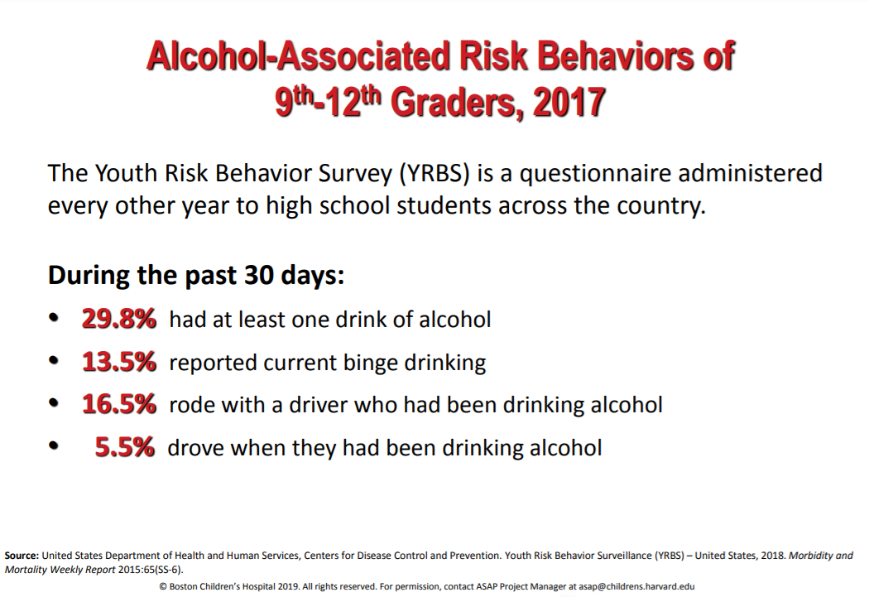

Slide 29
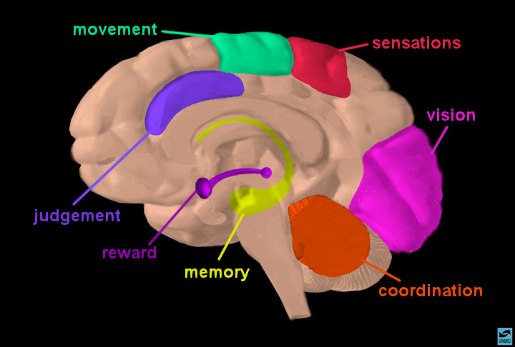
Marijuana Binds Cannabinoid Receptors Located Throughout the Brain (source NIDA)
Exposure to cannabis during adolescence …
…can affect neurobehavioral functions, especially cognition, emotional functioning, the risk of psychosis, and addiction.
…it’s thought to interfere with the normal trajectories and mechanisms underlying brain maturation.
Sources: Rubino and Parolaro, 2014; Bossong and Niesink, 2010; Renard et al., 2016).
.
.
.
.
.
.
.
.
.
.
.
.
.
.
.
.
.
.
.
.
.
.
.
.
.
.
.
.
.
.
.
.
.
.
.
.
.
.
.
.
.
.
.
.
.
.
.
.
.
.
.
.
.
.
.
.
.
.
.
.
.
.
.
.
.
.
.
.
.
.
.
.
.
.
.
.
.
.
.
.
.
.
.
.
.
.
.
.
.
.
.
.
.
.
.
.
.
.
.
.
.
.
.
.
.
.
.
.
.
.
.
.
.
.
.
.
.
.
.
.
.
.
.
.
.
.
.
.
.
.
.
.
.
.
.
.
.
.
.
.
.
.
.
.
.
.
.
.
.
.
.
.
.
.
.
.
.
.
.
.
.
.
.
.
.
.
.
.
.
.
.
.
.
.
.
.
.
.
.
.
.
.
.
.
.
.
.
.
.
.
.
.
.
.
.
.
.
.
.
.
.
.
.
.
.
.
.
.
.
.
.
.
.
.
.
.
.
.
.
.
.
.
.
.
.
.
.
.
.
.
.
.
.
.
.
.
.
.
.
.
.
.
.
.
.
.
.
.
.
.
.
.
.
.
.
.
.
.
.
.
.
.
.
.
.
.
.
.
.
.
.
.
.
.
.
.
.
.
.
.
.
.
.
.
.
.
.
.
.
.
.
.
.
.
.
.
.
.
.
.
.
.
.
.
.
.
.
.
.
.
.
.
.
.
.
.
.
.
.
.
.
.
.
.
.
.
.
.
.
.
.
.
.
.
.
.
.
.
.
.
.
.
.
.
.
.
.
.
.
.
.
.
.
.
.
.
.
.
.
.
.
.
.
.
.
.
.
.
.
.
.
.
.
.
.
.
.
.
.
.
.
.
.
.
.
.
.
.
.
.
.
.
.
.
.
.
.
.
.
.
.
.
.
.
.
.
.
.
.
.
.
.
.
.
.
.
.
.
.
.
.
.
.
.
.
.
.
.
.
.
.
.
.
.
.
.
.
.
.
.
.
.
.
.
.
.
.
.
.
.
.
.
.
.
.
.
.
.
.
.
.
.
.
.
.
.
.
.
.
.
.
.
.
.
.
.
.
.
.
.
.
.
.
.
.
.
.
.
.
.
.
.
.
.
.
.
.
.
.
.
.
.
.
.
.
.
.
.
.
.
.
.
.
.
.
.
.
.
.
.
.
.
.
.
.
.
.
.
.
.
.
.
.
.
.
.
.
.
.
.
.
.
.
.
.
.
.
.
.
.
.
.
.
.
.
.
.
.
.
.
.
.
.
.
.
.
.
.
.
.
.
.
.
.
.
.
.
.
.
.
.
.
.
.
.
.
.
.
.
.
.
.
.
.
.
.
.
.
.
.
.
.
.
.
.
.
.
.
.
.
.
.
.
.
.
.
.
.
.
.
.
.
.
.
.
.
.
.
.
.
.
.
.
.
.
.
.
.
.
.
.
.
.
.
.
.
.
.
.
.
.
.
.
.
.
.
.
.
.
.
.
.
.
.
.
.
.
.
.
.
.
.
.
.
.
.
.
.
.
.
.
.
.
.
.
.
.
.
.
.
.
.
.
.
.
.
.
.
.
.
.
.
.
.
.
.
.
.
.
.
.
.
.
.
.
.
.
.
.
.
.
.
.
.
.
.
.
.
.
.
.
.
.
.
.
.
.
.
.
.
.
.
.
.
.
.
.
.
.
.
.
.
.
.
.
.
.
.
.
.
.
.
.
.
.
.
.
.
.
.
.
.
.
.
.
.
.
.
.
.
.
.
.
.
.
.
.
.
.
.
.
.
.
.
.
.
.
.
.
.
.
.
.
.
.
.
.
.
.
.
.
.
.
.
.
.
.
.
.
.
.
.
.
.
.
.
.
.
.
.
.
.
.
.
.
.
.
.
.
.
.
.
.
.
.
.
.
.
.
.
.
.
.
.
.
.
.
.
.
.
.
.
.
.
.
.
.
.
.
.
.
.
.
.
.
.
.
.
.
.
.
.
.
.
.
.
.
.
.
.
.
.
.
.
.
.
.
.
.
.
.
.
.
.
.
.
.
.
.
.
.
.
.
.
.
.
.
.
.
.
.
.
.
.
.
.
.
.
.
.
.
.
.
.
.
.
.
.
.
.
.
.
.
.
.
.
.
.
.
.
.
.
.
.
.
.
.
.
.
.
.
.
.
Slide courtesy of Maureen Boyle, PhD
Notes:
The different areas of the brain, as shown in the diagram show what it is responsible for.

Slide 30
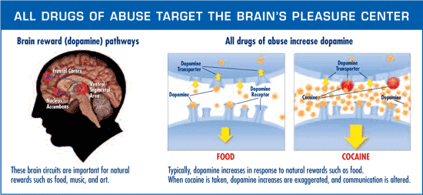
Notes:
The release of dopamine into your body can make some people feel really happy. But it can also cause more harmful effects, like extreme sleepiness, confusion, nausea, vomiting and constipation.

Slide 31
Brain Development
Teen Sexual Activity
Sexual Assault. Sexual assault, including rape, occurs most commonly among women in late adolescence and early adulthood, usually within the context of a date. Research suggests that alcohol use by the offender, the victim, or both, increases the likelihood of sexual assault by a male acquaintance.
High–Risk Sex. Research has associated adolescent alcohol use with high–risk sex (for example, having multiple sexual partners, failing to use condoms, and having unplanned sex). The consequences of high–risk sex also are common in this age group, particularly unwanted pregnancy and sexually transmitted diseases, including HIV/AIDS.
Informed Families | Copyright 2021 | Proprietary
Notes:
31

Slide 32
Brain Development
Academics/School
School problems, such as higher absence and poor or failing grades.
Violence
________________________________________________________________________
Teens are more likely to engage in fights or may act out against their peers, parents, siblings etc.
Informed Families | Copyright 2021 | Proprietary
Notes:
32

Slide 33
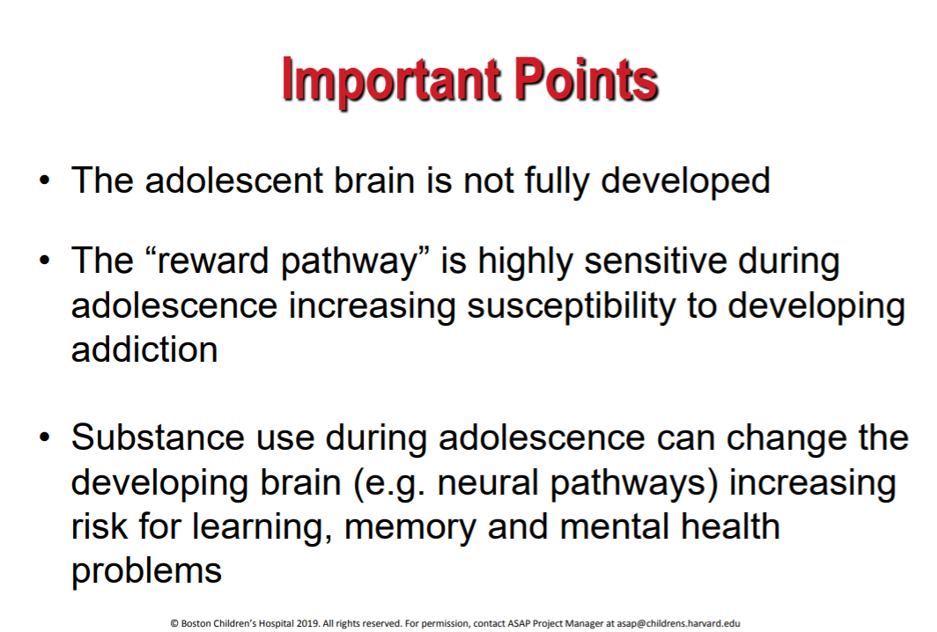

Slide 34
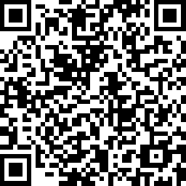
End of Agenda 1
Post Survey
https://www.surveymonkey.com/r/PPGAgenda1-post
Notes:
Provide post-test for Agenda 1 https://www.surveymonkey.com/r/PPGAgenda1-post

Slide 35
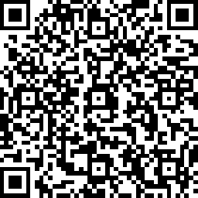
Agenda Two
Media
https://www.surveymonkey.com/r/PPGAgenda2-MediaPre
Informed Families | Copyright 2021 | Proprietary
Notes:
35
Provide Agenda 2 Pre-test (paper-based or link). https://www.surveymonkey.com/r/PPGAgenda2-MediaPre

Slide 36

Media-Television
What Do You See on TV?
____________________________________________________________________________________________________________________________________________________________________________________________________________________________
Informed Families | Copyright 2021 | Proprietary
Notes:
36

Slide 37
Media – Television
What do you see on TV?
Alcohol Advertisements. Younger adolescents appear to be susceptible to the persuasive messages contained in alcohol commercials broadcast on TV, which sometimes results in a positive affective reaction to the ads. Alcohol ad exposure and the affective reaction to those ads influence some youth to drink more and experience drinking-related problems later in adolescence.
-2013 by the American Academy of Pediatrics
Violence. Too much exposure to violence through media — especially on TV — can desensitize children to violence. As a result, children might learn to accept violent behavior as a normal way to solve problems.
Informed Families | Copyright 2021 | Proprietary
Notes:
37

Slide 38
Facts about Television
Informed Families | Copyright 2021 | Proprietary
The average 5th grader watches more than 3 hours a day.
With the increase of “new media” (computers, internet and video games), children are multitasking and still watching just as much TV.
53% of 8–18-year-old youth, say their families have no rules about TV watching. 46% say they do have rules, but just 20% say their rules are enforced most of the time.
Average parents watch 2 hours a day
Notes:
38

Slide 39
Alcohol Advertising
$5 billion a year
Normalize heavy drinking
Links sex and happiness to drinking
Designed to develop certain attitudes about drinking
Use humor, music and cute animals to appeal to young viewers.
Young people see more ads for beer than juice, jeans, chips, sneakers or gum
Informed Families | Copyright 2021 | Proprietary
Notes:
39

Slide 40
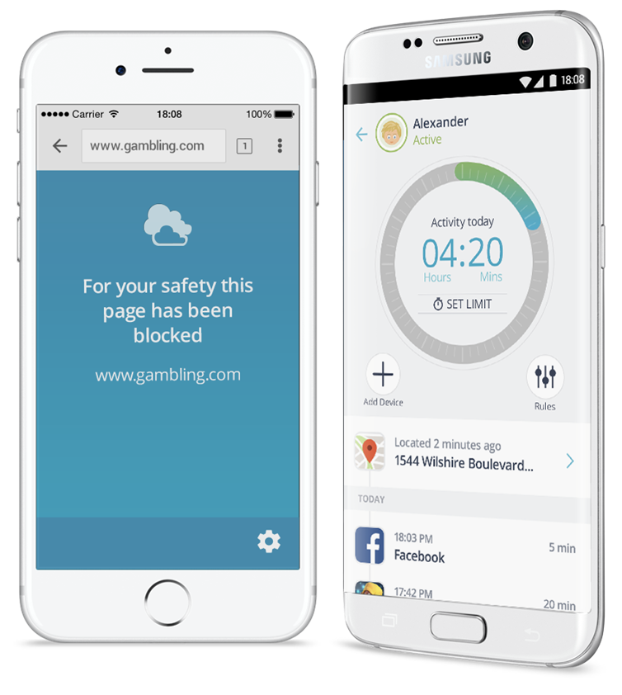
Marketing TACTICS
https://www.dropbox.com/sh/3ry9l0y4ib065sv/AABRlUwBmJaBUB0HBkhNYZ38a?dl=0&preview=24.+Middle+%26+High+School+Social+Media.mp4
Notes:
https://www.dropbox.com/sh/piz5aegbxo3rjgv/AAD2CGV48mBTosDMViqMxSPea?dl=0

Slide 41
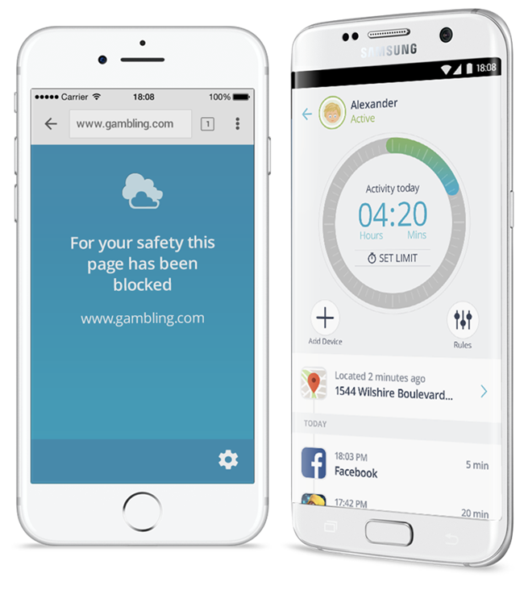

FACTS TO CONSIDER
Social media usage is now ubiquitous among US teens; 71% use more than one social platform.
Teens nowadays also spend an enormous amount of time on social media. A survey by the non-profit group Common Sense Media showed that 13- to 18-year-olds spend a whopping nine hours a day!

Slide 42
Television Parenting Tips
Set Limits for watching television
Take TVs & Screens out of bedrooms
Screen and select programs
Watch TV with your children
Watch recorded programs.
Fast-forward through commercials.
Dinner is an excellent time for TV- free time.
Use dinner time to ask your children open-ended questions.
Ex: What was the best or worst thing that happened to you today?
Informed Families | Copyright 2021 | Proprietary
Notes:
42

Slide 43



Media-Ads
Ad Credit: Ben Cort, Foundry Steamboat

Slide 44
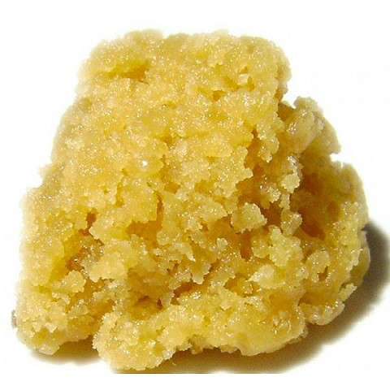

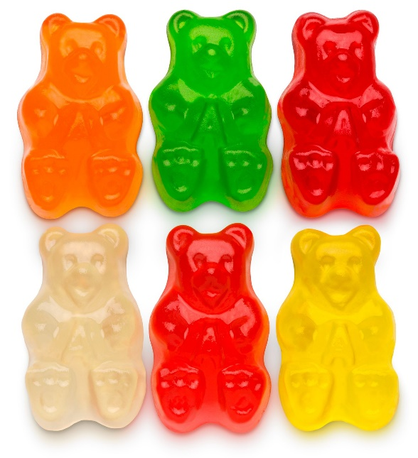
Consumption Trends – Beyond Smoking
Concentrates
Edibles
Vape
Ad Credit: Ben Cort, Foundry Steamboat

Slide 45
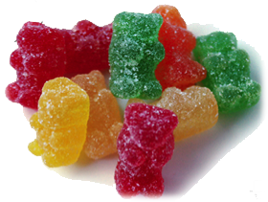
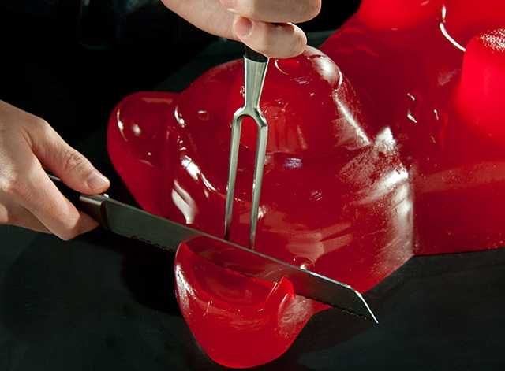
Edibles
Media
10 mg is a legal dose
So……..

Slide 46


Media
Ad Credit: Ben Cort, Foundry Steamboat

Slide 47
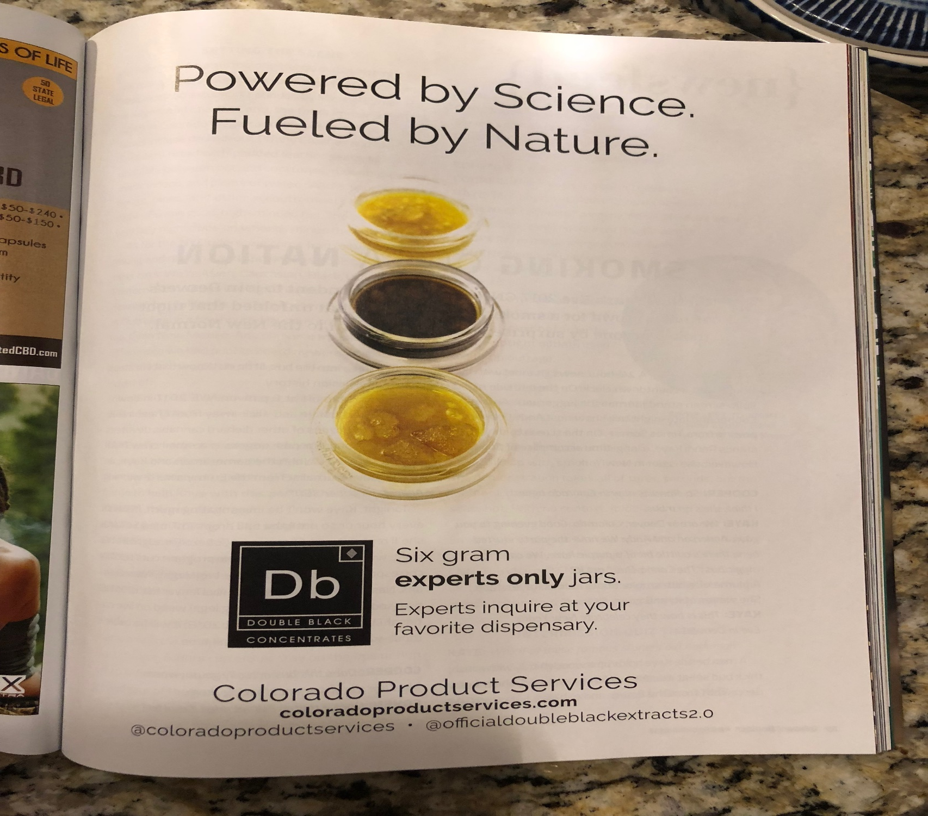
“Weed” Redefined

Slide 48
Media – Internet Safety
Internet Safety Statistics
How are online issues affecting children?
Take a glance at these statistics to find out.
Access
93% of teens (12-17) go online.
Of the children (0-5) who use the Internet, 80% use it at least once a week.
Informed Families | Copyright 2021 | Proprietary
Notes:
48

Slide 49
Media – Internet Safety
Cell Phones
75% of teens (12-17) have cell phones.
On average, texting teens (12-17) send and receive 1500 text messages a month.
Cyberbullying
1 in 3 teens (12-17) have experienced online harassment.
Girls are more likely to be victims of cyberbullying (38% girls vs. 26% boys).
Informed Families | Copyright 2021 | Proprietary
Notes:
49

Slide 50
Online Gaming
97% of teens (12-17) play computer, web, portable, or console games.
27% of teens (12-17) play games with people they don’t know online.
Predators
Predators seek youths vulnerable to seduction, including those with histories of sexual or physical abuse, those who post sexually provocative photos/video, and those who talk about sex with unknown people online.
1 in 25 youths received an online sexual solicitation where the solicitor tried to make offline contact.
In more than one-quarter (27%) of incidents, solicitors asked youths for sexual photographs of themselves.
Informed Families | Copyright 2021 | Proprietary
Notes:
50

Slide 51

Improper Usage of Mobile

Slide 52
WHAT IS Sexting?
The act of sending sexually explicit messages to other people’s cell phones. These messages can be in the form of a text, photo, or video.
********
It can have serious legal and psychological consequences for your teen/tween.

Slide 53
Sexting
4% of cell-owning teens (12-17) say that they have sent sexually suggestive nude/semi-nude messages to others via text message.
15% of cell-owning teens (12-17) say they have received sexually suggestive nude/semi-nude images of someone they know via text.
Social Networking
73% of teens (12-17) have profiles on social networking sites.
47% of teens (12-17) have uploaded photos; 14 % have posted videos.
Informed Families | Copyright 2021 | Proprietary
Notes:
53

Slide 54
Internet Safety Parenting Tips
Educate Yourself
Learn about Parent Controls:
◘ http://www.wiredsafety.org
◘ http://www.netsmartz.org
◘ http://www.safekids.com
◘ http://ilearn.isafe.org
Educate Your Children: Teach your children safe, private and responsible technology use. Communicate the dangers and consequences of posting inappropriate or too much personal information.
Informed Families | Copyright 2021 | Proprietary
Notes:
54

Slide 55
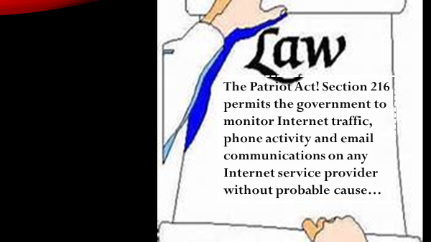
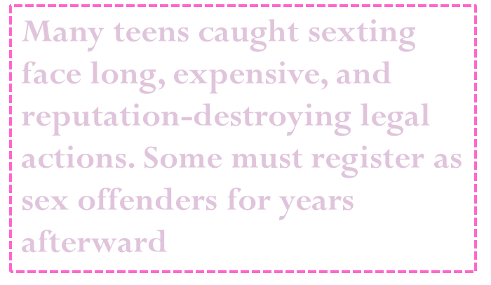

Slide 56
Internet Safety Parenting Tips
Informed Families | Copyright 2021 | Proprietary
Communicate
Keep The Computer In The Living Room
Set Limits
Be Consistent
Trust Your Judgment
Notes:
56

Slide 57

Top Ten Internet Acronyms Every Parent
Should Know
10. KFY – Kiss for You
9. KPC – Keeping parents clueless
8. ADR – Address
7. LMIRL – Let’s meet in real life
6. A/S/L – Age/Sex/Location
5. 420 – Marijuana 710 –Vape
4. PAW – Parents are watching
3. P911 – Parent alert
2. PIR – Parents in room
1. POS – Parent over shoulder
Notes:
57

Slide 58
Possible Consequences of Sexting
IT’S A PUNISHABLE FELONY!
Anyone under 18 – even yourself – could get you slapped with child pornography charges (sex offender for life)
Info and pictures are exposed to being shared (ex. teachers/parents)
Photos can leak online and go viral
Improper use can cause bad reputation

Slide 59
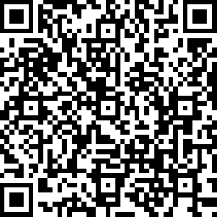
End of Agenda 2
Media-Post Survey
https://www.surveymonkey.com/r/Agenda2Media-Post
Notes:
https://www.surveymonkey.com/r/Agenda2Media-Post

Slide 60
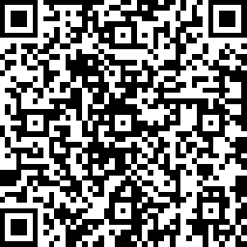
Agenda Three
Social Norms
https://www.surveymonkey.com/r/PPGAgenda3-Norms-pre
Notes:
60
Handout Pre-Surveys – Social Norms and Parent Peer Groups or Use Link: https://www.surveymonkey.com/r/PPGAgenda3-Norms-pre

Slide 61
What are social norms?
Rules that a group uses for appropriate and inappropriate values, beliefs, attitudes and behaviors.
Social Norms are things that control our actions and thoughts, which we are not even aware of.
Notes:
61

Slide 62
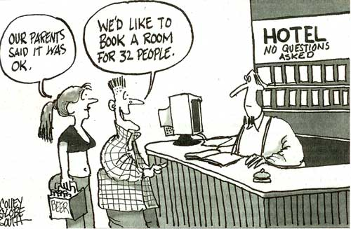
Is This Normal To You?
Notes:
62

Slide 63


Think About Your Social Norms
What image comes to mind when you hear the word “celebrate?”
Notes:
63

Slide 64
Social Norms
Watch your thoughts; they become words.
Watch your words; they become actions.
Watch your actions; they become habits.
Watch your habits; they become character.
Watch your character; it becomes your destiny.
Knowledge is POWER!
Knowledge does NOT create change!
PEOPLE create change!
YOU ARE THE PILOT OF YOUR LIFE!
Notes:
- See section 2 (page 17) in reference material

Slide 65
What are some things you consider the NORM now that are different from when you were growing up?_________________
____________________________________________________
Social Norms Influence Underage Drinking

Slide 66
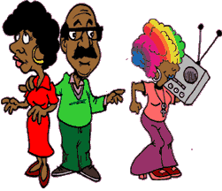
Think About Your Social Norms
Did you drink before you were 21 or use drugs in your youth?
What do you consider to be normal behavior for a teenager?
Notes:
66

Slide 67
Social Norms Influence Underage Drinking
The average 6th grader believes that 1/2 of his or her peers drink alcohol-well above the social norm
6th, 7th, and 8th graders are 9 times more likely to smoke and 5 times more likely to drink if they had 2 or more friends who smoke and drank (NIH study)
Notes:
67

Slide 68

Let’s Do An Environmental Scan
What are some of the social norms in your child’s world?
How are these social norms developed and promoted?
Notes:
68

Slide 69
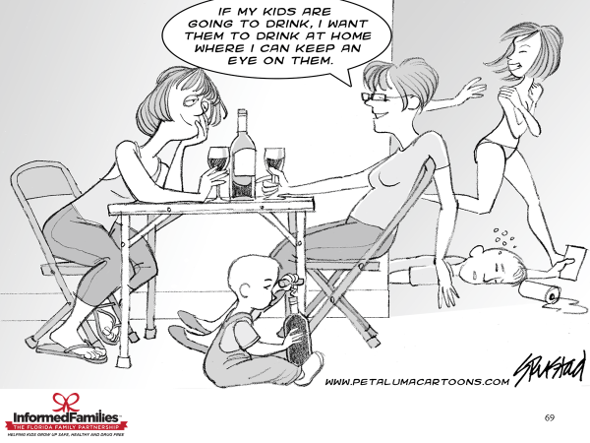

Slide 70
Social Norms & Alcoholism
1 in 4 Children are exposed to Family Alcohol Abuse (NIH Study)
Children in families affected by alcohol often live-in environments that are:
  stressful
  chaotic
  frightening
Children of alcoholics are 4 times more likely to become alcoholics
Notes:
70

Slide 71
What are the benefits of the Minimum Legal Drinking Age?
Raising the minimum drinking age…
Reduces alcohol consumption and related problems amongst youth
Saves lives
Prevents adolescent brain damage
Notes:
71

Slide 72
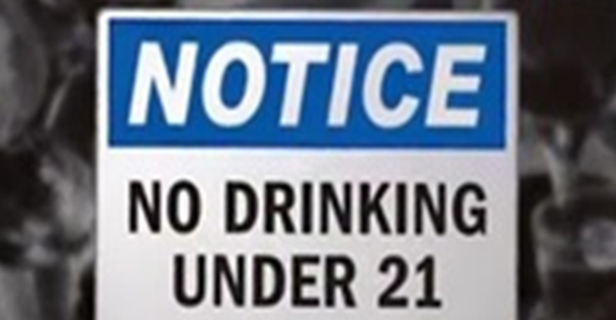

What is the legal drinking age in FL?

Slide 73

Every year in Florida there are more than
16,000 CRASHES in which alcohol is suspected.
7,000 INJURIES &
800 DEATHS yearly.

Slide 74

Is your child at risk?
There are many reasons that kids drink or use drugs, but the most obvious reasons can be found by understanding risk and protective factors.
Notes:
74

Slide 75
What are risk & protective factors?
As kids grow up, they are exposed to a number of factors which may either Increase their risk for, or protect them from, problems such as abusing drugs or engaging in delinquent behavior.
Notes:
75

Slide 76
Example of a Risk Factor
Family management problems.
If parents fail to set standards for their teen’s
behavior, the teen is more likely to use
drugs or engage in delinquent behavior.
Notes:
76

Slide 77
More Examples of Risk Factors
Early and persistent antisocial behavior
Family Conflict
Academic Failure
Gang Involvement
Extreme economic deprivation
Notes:
77

Slide 78
More Examples of Protective Factors
Peer groups, school, and communities that emphasize positive social norms
Warm, supportive relationships and bonding with adults
Opportunities to become involved in positive activities
Recognition and support for participating in positive activities
Healthy beliefs and clear standards
Notes:
78

Slide 79

What Does All of This Mean?
Once we understand exactly
why some of our children are
using and abusing drugs, and
engaging in other risky behavior,
we can decide exactly what to
do about it.
Notes:
79

Slide 80
Let’s Discuss:
Are the social norms positive or negative to the growth and development of your child?
______________________________________________________
______________________________________________________
What can you do about it?
______________________________________________________

Slide 81
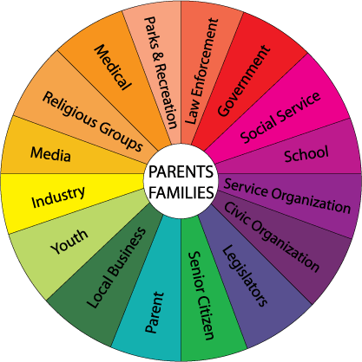
It Takes A Village…
All sectors of the community must be united to make a change
Notes:
81

Slide 82
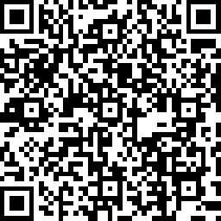
End of Agenda 3
Social Norms Post Survey
https://www.surveymonkey.com/r/PPGAgenda3-Norms-post
Notes:
Time for the Post-survey. Handout paper-based tests or use link: https://www.surveymonkey.com/r/PPGAgenda3-Norms-post

Slide 83
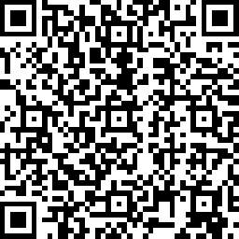
Agenda Four
Parent Peer Groups
https://www.surveymonkey.com/r/PPGAgenda4-Groups-pre
Notes:
Handout Pre-Test for Agenda 4 or use the link provided: https://www.surveymonkey.com/r/PPGAgenda4-Groups-pre
83

Slide 84
Different Parenting Styles
The Sergeant (strict, rigid)
The Ghost Parent (present, but not present)
The Helicopter (always around, hovering)
Notes:
84

Slide 85
What is a Parent Peer Group?
A parent peer group is a group of parents whose children are friends, neighbors or classmates.
It is a parent’s most effective way to maintain their own sanity during the teenage years!!!
Notes:
85

Slide 86
What do Parent Peer Groups do?
Educate themselves about teenagers and effective parenting during the teen years
Talk to each other
Set common rules for their children
Agree to consequences for breaking the rules
Monitor their own children’s behaviors
Notes:
86

Slide 87
What Else do Parent Peer Groups do?
Enforce consequences with their own children
Share stories and information with other parents about their children’s behavior
Help their children plan and hold fun and appropriate activities
Act as a support group for each other and for the children
Notes:
87

Slide 88
What is a Guideline?
An agreed upon code of behavior for the children in the parent peer group
For example, all the parents in the group decide that their kids should not be smoking cigarettes. They work together to enforce that rule and make sure that none of their children smoke.
Notes:
88

Slide 89
Steps to Forming a Parent Peer Group
Read the Parent Pilot Kit
Find 2 other parents/volunteers to create a team
Divide the duties/roles
  Recruiter (Asks parents to join)
  Facilitator (Finds a location, time)
  Presenter (Shares information)
Notes:
89

Slide 90
Steps to Form a PPG (continued)
Determine how to invite the parents – do you want to call them up or create written invitations?
Recruit approximately 10-20 parents to come to the first meeting, or as many as you can
Make the first meeting a fun overview of what you want to accomplish with a friendly atmosphere where parents can relax and get to know each other
Notes:
90

Slide 91
Steps to Form a PPG (continued)
Agree to meet on a regular basis as a group
Establish a phone/address list
If many of the parents have internet access, establish an e-mail list and agree to communicate by e-mail
Notes:
91

Slide 92

In Summary
Informed Families | Copyright 2021 | Proprietary
The purpose of forming a parent peer group is to support each other through difficult times, provide advice and helpful information to each other and to set some rules for your children to follow as a group.
Notes:
92

Slide 93
Make a list of those you feel can join us.
Informed Families | Copyright 2021 | Proprietary
Share some ideas:
  Teachers
  Family Members
  Friends
  Neighbors
  PTA Members
Notes:
93

Slide 94
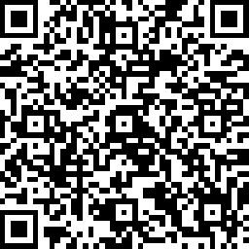
Agenda 4
Parent Peer Groups Post Survey
https://www.surveymonkey.com/r/PPGAgenda4-Groups-post
Notes:
Handout Agenda 4 Post-Tests (Paper-based) or use provided link:
https://www.surveymonkey.com/r/PPGAgenda4-Groups-post

Slide 95
Part II
Helpful Tools
91
Notes:
Point to this section of the PPK

Slide 96
Helpful Tools
General Sites:
www.informedfamilies.org
Informed Families of Dade County, Inc.
www.nfp.org
National Family Partnership
www.fadaa.org
Florida Alcohol and Drug Abuse Association
www.samhsa.gov
Substance Abuse and Mental Health Services Administration

Slide 97
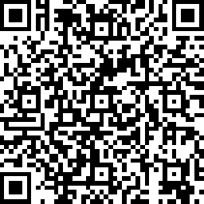
PPG Training
Post-Survey
https://www.surveymonkey.com/r/PPGPRE1234
Notes:
Complete the survey here ONLY if the individual surveys were not administered throughout the presentation, otherwise use this link. https://www.surveymonkey.com/r/PPGPRE1234

Slide 98
PPG Certification Training Available
Ask for details
cstilwell@informedfamilies.org
Notes:
Marketing and Recruiting - 15minutes

